Slide 1
SET OPERATORS

Slide 2
TYPES OF SET OPERATORS:
SQL supports few Set operations which can be performed on the table data. These are used to get meaningful results from data stored in the table, under different special conditions.
In this tutorial, we will cover 4 different types of SET operations, along with example:
UNION
UNION ALL
INTERSECT
MINUS

Slide 3
RULES
✓No of columns should same within both selected statements.
✓Order of the columns should be same.
✓Data types of the column must be match.

Slide 4
UNION Operation
UNION is used to combine the results of two or more SELECT statements. However it will eliminate duplicate rows from its resultset. In case of union, number of columns and datatype must be same in both the tables, on which UNION operation is being applied.
union set operation in sql

Slide 5
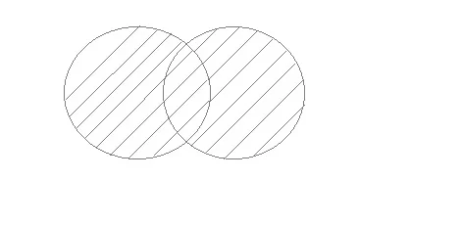
Example of UNION
The First table,
ID Name
1 abhi
2 adam
The Second table,
ID Name
2 adam
3 Chester
Union SQL query will be,
SELECT * FROM First
UNION
SELECT * FROM Second;
The resultset table will look like,
ID NAME
1 abhi
2 adam
3 Chester

Slide 6
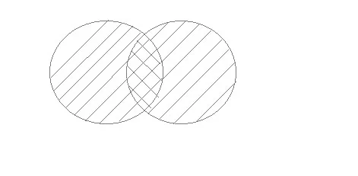
UNION ALL
This operation is similar to Union. But it also shows the duplicate rows.
union all set operation in sql

Slide 7
Example of Union All
The First table,
ID NAME
1 abhi
2 adam
The Second table,
ID NAME
2 adam
3 Chester
Union All query will be like,
SELECT * FROM First
UNION ALL
SELECT * FROM Second;
The resultset table will look like,
ID NAME
1 abhi
2 adam
2 adam
3 Chester

Slide 8
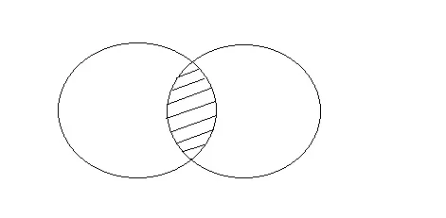
INTERSECT
Intersect operation is used to combine two SELECT statements, but it only retuns the records which are common from both SELECT statements. In case of Intersect the number of columns and datatype must be same.

Slide 9
Example of Intersect
The First table,
ID NAME
1 abhi
2 adam
The Second table,
ID NAME
2 adam
3 Chester
Intersect query will be,
SELECT * FROM First
INTERSECT
SELECT * FROM Second;
The resultset table will look like
ID NAME
2 adam

Slide 10
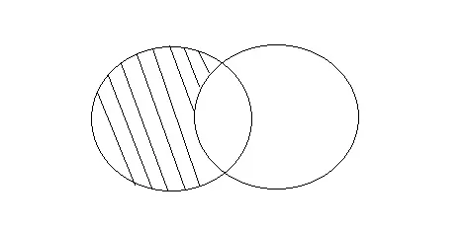
MINUS
The Minus operation combines results of two SELECT statements and return only those in the final result, which belongs to the first set of the result.

Slide 11
Example of Minus
The First table,
ID NAME
1 abhi
2 adam
The Second table,
ID NAME
2 adam
3 Chester
Minus query will be,
SELECT * FROM First
MINUS
SELECT * FROM Second;
The resultset table will look like,
ID NAME
1 abhi

Slide 12
END

